Slide 1

GEP TECHATHON 2020
Problem - Scheduled File Converter
Team - YetAnotherTrio

Slide 2


Team YetAnotherTrio
Team Members
Mentor : Sanjay Prajapati
Ayush Raj
Pavankumar Valiveti
Abhishek Sharma

Slide 3
PROBLEM STATEMENT
PROBLEM STATEMENT 01
SCHEDULER TO AUTO PICK A DIFFERENT FILE FROM BLOB AND CONVERT IT INTO CSV
REQUIREMENTS
Scheduler should auto pick a different file from Blob and convert it into CSV file, if required
A Scheduler should be running in every 30 sec, which would auto pick a xls/xlsx/CSV/Text file from Blob and convert it into CSV file. Microsoft Logic App can be used to do this.
Converted CSV File uploaded at same blob location
Find for optimum solution to convert xls/xlsx/CSV/Text files
You may explore using some Azure/External services to implement this
Test and demo using the WebApp

Slide 4
Solution Approach

Slide 5
Approach
User Uploads file(s) to the Azure Blob Storage Location
A time trigger which was already checking for new files every 30 seconds, picks this non-converted file and passes it to the converter
The Converter converts the file into CSV and uploads the file at the same location.
Logs for this conversion are stored in a designated log file, available to the UI
A tracker from the UI keeps checking for the newly converted files after a certain interval

Slide 6
Tech Stack Used
UI
React
HTML 5/CSS 3
JavaScript
Axios
Azure Functions
C# , .NET Core
Azure Blob Storage
Azure File Share
ExcelDataReader
Server Side
C# / .NET
Azure Services

Slide 7

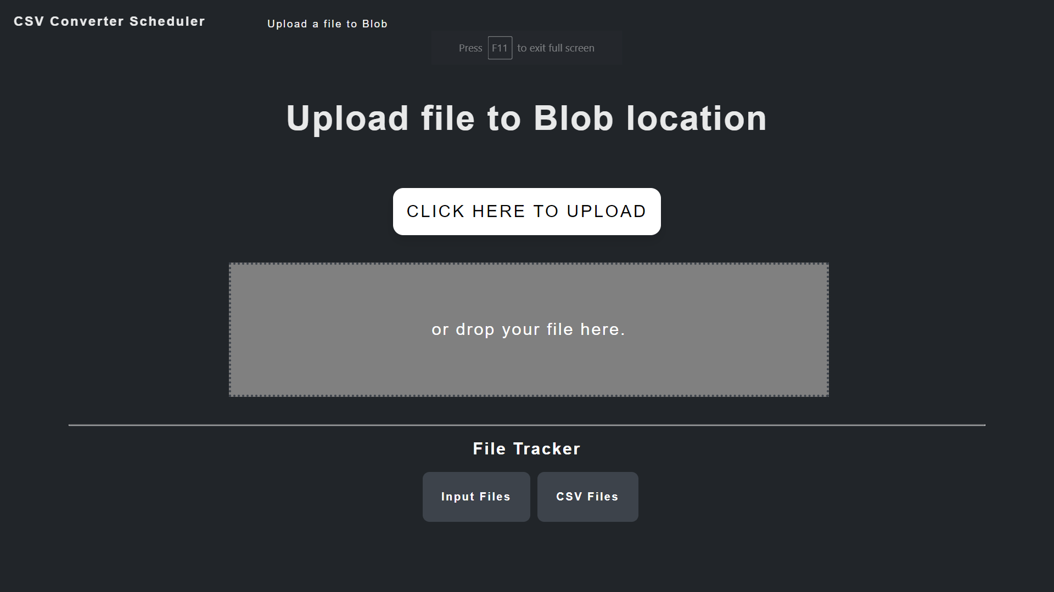

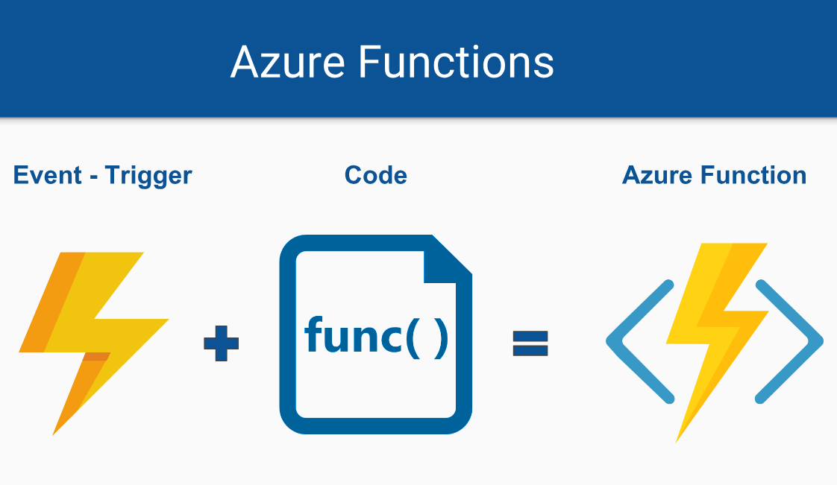
Structure of the Project
Screenshot of ui
User Interface

Slide 8

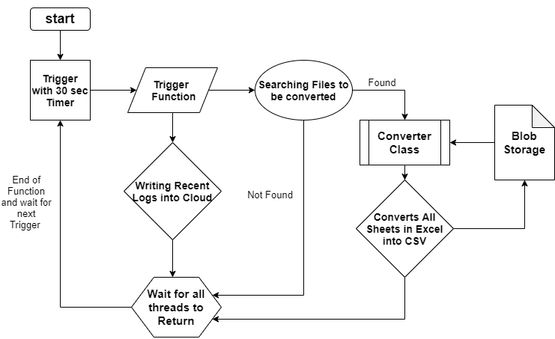
Azure Functions
Downloading Excel from Blob
Flow Diagram :
Uploading CSV file into Blob

Slide 9
Application Programming Interface (API)
About the APIs
.NET on C# was used to provide an interface between the UI and the Azure Blob Storage, providing the user with CRUD functionalities.
List Files ( HTTP GET ):
Returns the list of file names from blob location.
Insert File ( HTTP POST ):
Uploads file to the blob location
Delete File ( HTTP DELETE ):
Deletes file from blob location.
Download File ( HTTP GET ):
Downloads file from blob location
Get Logs ( HTTP GET ):
Returns log file’s content from azure file shares.

Slide 10
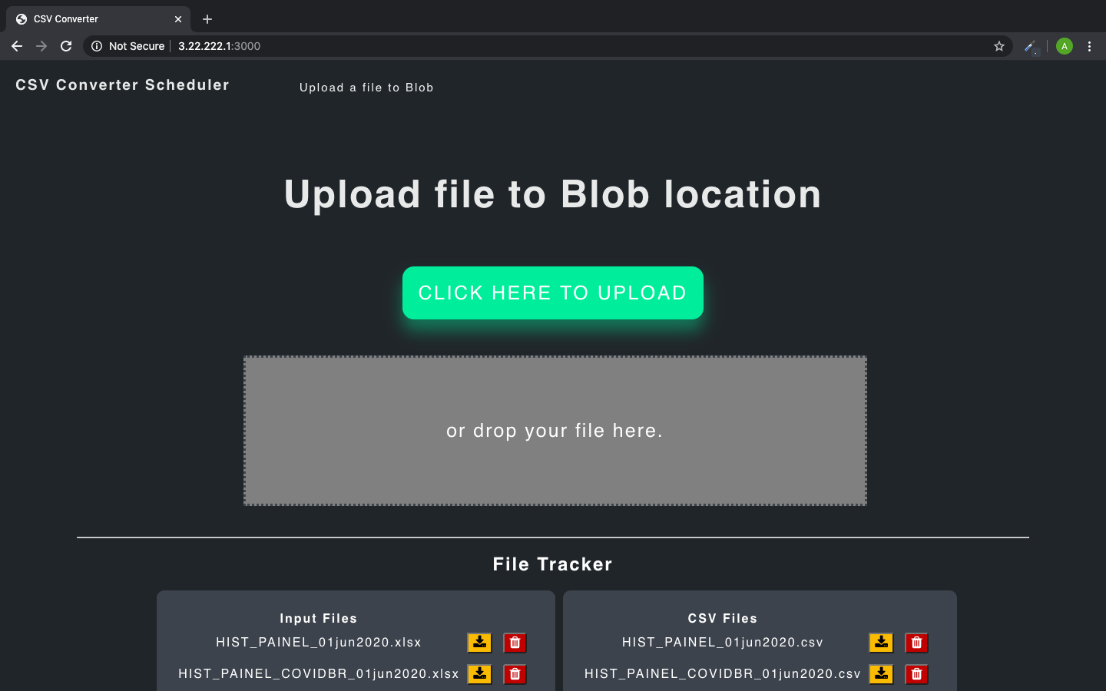
User Interface
Web App UI
The UI is based on React, since dynamic upgradation of components like the file-tracker was one of the requirements.
Axios was used for generating API requests, and getting responses.
Azure’s Block REST APIs were used for uploading large files.
HTML/CSS features were used for styling.
UI
Basic Functionalities
Uploads file to the Azure blob location through file selector or Drag n drop.
Large files are divided into smaller chunks for uploading.
Tracks the input files and the converted files
Maintains a log of Azure function

Slide 11
DEMO

Slide 12
CHALLENGES FACED
User Interface
Uploading a large file as chunks of smaller files.
Creating a logger for the Azure function.
APIs
Making connection with Blob Service and File Service.
Reading, writing, downloading, deleting files at Blob Storage.
Azure functions
Uploading large converted CSV files into Blob Storage.
Reading and updating recent 50 logs in a separate Log file in File Share.
Filtering Files that are to be converted in the Blob Storage.
Optimising Converter Function.

Slide 13
What did we learn from the project?
Most of the technologies used in the development stack of the project, including Azure functions and React, were relatively new to the team members. Learning these technologies in the given time constraints and implementing them to achieve the requirements of the project was a big task.
Learnt in depth about optimizing Azure functions, Blob trigger and Time trigger.
Teamwork, a naive but important point.

Slide 14
Thank you!

